Slide 1
Knowledge representation

Slide 2
Knowledge Representation (KR)
Knowledge Representation (KR) is the process of representing knowledge in a form that a computer/AI system can understand, store, reason with, and use to make decisions.

Slide 3
Course Outcome:
Use suitable knowledge representation techniques for AI-based applications.
Session Outcomes
Understand Knowledge Representation approaches.
Represent and map facts using formal representations.
Customize a Knowledge Representation model for an AI application.

Slide 4
example
Suppose we tell an AI system:
Ravi is a student.
Ravi studies Artificial Intelligence.
Every student has an ID.
A computer cannot reason effectively from these statements if they are stored only as ordinary English sentences.
Instead, we can represent them formally:
Student(Ravi)
Studies(Ravi, ArtificialIntelligence)
Student(x) → HasID(x)
Now the AI system can use these representations to derive additional information.

Slide 5
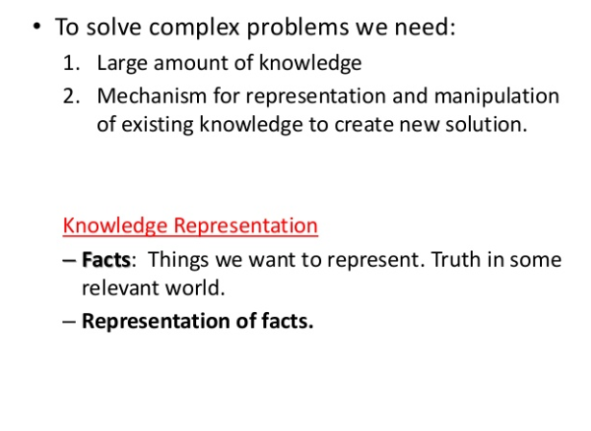
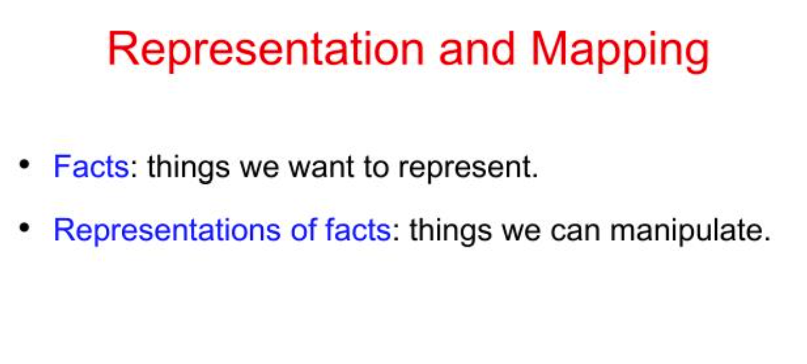

Slide 6
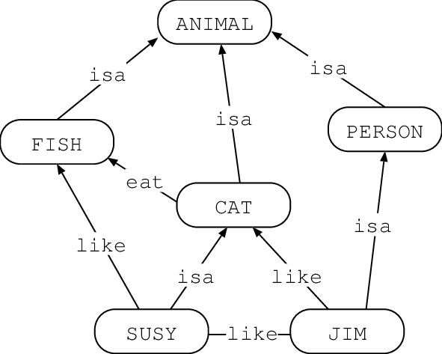
Knowledge representation
The Knowledge Representation models/mechanisms are often based on:
• Logic
• Rules
• Frames
• Semantic Net
Frames represent a pivotal concept that helps machines understand and interpret complex real-world scenarios.
Each frame consists of a set of attributes and values, forming a template for understanding specific situations.
For instance, a "restaurant" frame might include attributes such as "menu," "waitstaff," and "tables," each with its own set of details.

Slide 7
Logic
Logic represents knowledge using formal statements.
Example:
Human(Socrates)
Human(x) → Mortal(x)
From these two statements:
Mortal(Socrates) can be inferred.

Slide 8
rules
Rules represent knowledge using IF–THEN conditions.
Example:
IF temperature > 100°C
THEN overheating = TRUE
Another AI example:
IF patient has fever AND cough
THEN possible_flu
Rules are widely used in expert systems.

Slide 9
frames
A frame represents an object or situation using attributes and values.
Eg:Restaurant frame, containing attributes such as:
Menu
Waitstaff
Tables
We can represent it as:
RESTAURANT
----------------
Menu → Indian Food
Waitstaff → 5
Tables → 20
Location → Coimbatore
So a frame is similar to a template describing an object.

Slide 10
Semantic network
A semantic network represents knowledge using nodes and relationships.
Example:
is-a
Dog ------------> Animal
|
| has
↓
Tail
Here:
Dog = node
Animal = node
is-a = relationship
Tail = another node
The AI can understand that:
Dog → Animal
and therefore a dog is an animal.

Slide 11
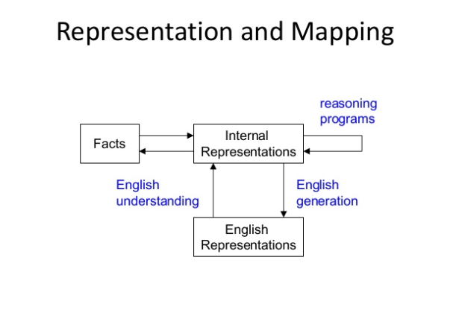

Slide 12
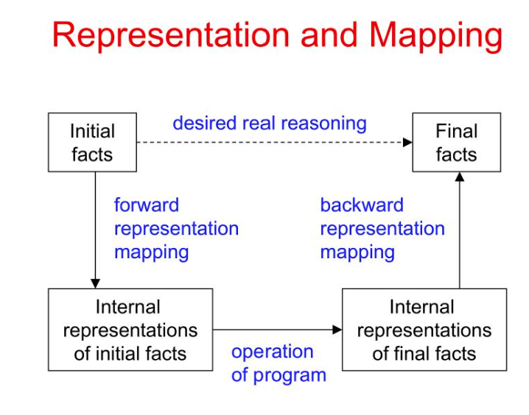

Slide 13
Representation & Mapping
Spot is a dog.
  dog(Spot)
Every dog has a tail.
  ∀x (dog(x) → hastail(x))
Spot has a tail.
  hastail(Spot)
All humans are mortal. Socrates is a human.
  ∀x (Human(x) → Mortal (x))
  Human(Socrates)
  Mortal(Socrates)
All cats are animals.
  ∀x (Cat(x) → Animal(x))
Cats eat fish.
  ∀x (Cat(x) → Eats(x, Fish))
All parents love their children.
  ∀x∀y (Parent(x,y) → Loves(x,y))
Every student is enrolled in the course Artificial Intelligence.
  ∀x(Student(x)→Enrolled(x, Artificial Intelligence))
Every author of a book is a person.
  ∀x (Author(x, Book) → Person(x))
Note:
∀x
This means:For every x

Slide 14
Representation & Mapping
∀x (dog(x) → hastail(x))
For every x, if x is a dog, then x has a tail.
hastail(Spot)
We can obtain it from:
dog(Spot)
and
∀x(dog(x) → hastail(x))
Reasoning:
Spot is a dog.
↓
Every dog has a tail.
↓
Therefore Spot has a tail.

Slide 15
All humans are mortal. Socrates is a human.
Reasoning diagram
Rule
Human(x) ---------> Mortal(x)
↑
Socrates
Therefore:
Socrates is mortal.
This is a classic example of deductive reasoning.

Slide 16
Cats eat fish.
English:
Cats eat fish.
Representation:
∀x (Cat(x) → Eats(x, Fish))
Here we have a relationship between two entities.
Eats(Cat, Fish)
The predicate Eats() represents an action/relation.
Example
If:
Cat(Tom)
then:
Eats(Tom, Fish)
can be inferred.

Slide 17
All Parents Love Their Children
∀x∀y (Parent(x,y) → Loves(x,y))
Parent(x,y)
means:
x is a parent of y.
Loves(x,y)
means:
x loves y.
For every x and y, if x is a parent of y, then x loves y.

Slide 18
Every Student Is Enrolled in AI
∀x(Student(x) → Enrolled(x, ArtificialIntelligence))
Suppose:
Student(Ravi)
Then:
Enrolled(Ravi,ArtificialIntelligence)
Reasoning
Student(Ravi)
+
Every student is enrolled in AI
↓
Ravi is enrolled in AI

Slide 19
Every Author of a Book Is a Person
Representation:
∀x (Author(x, Book) → Person(x))
Here:
Author(x, Book)
means:
x is an author of the book.
Therefore:
Person(x)
can be inferred.
Example
If:
Author(Arundhati, Book)
then:
Person(Arundhati)

Slide 20
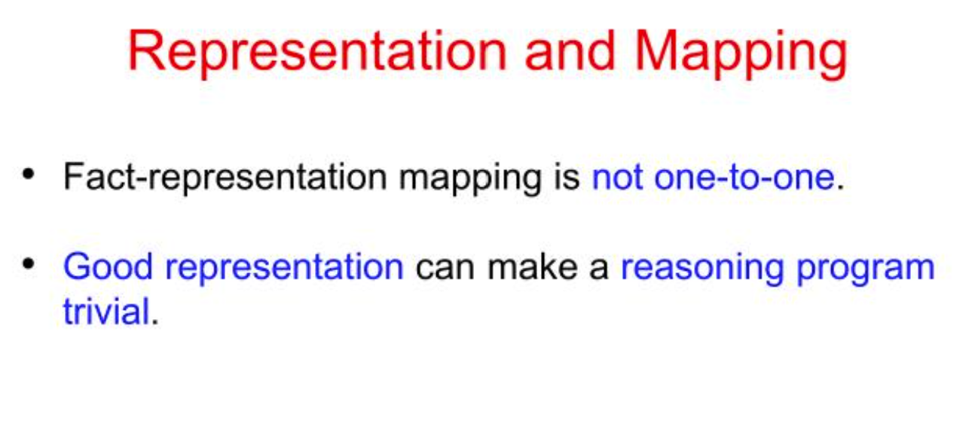

Slide 21
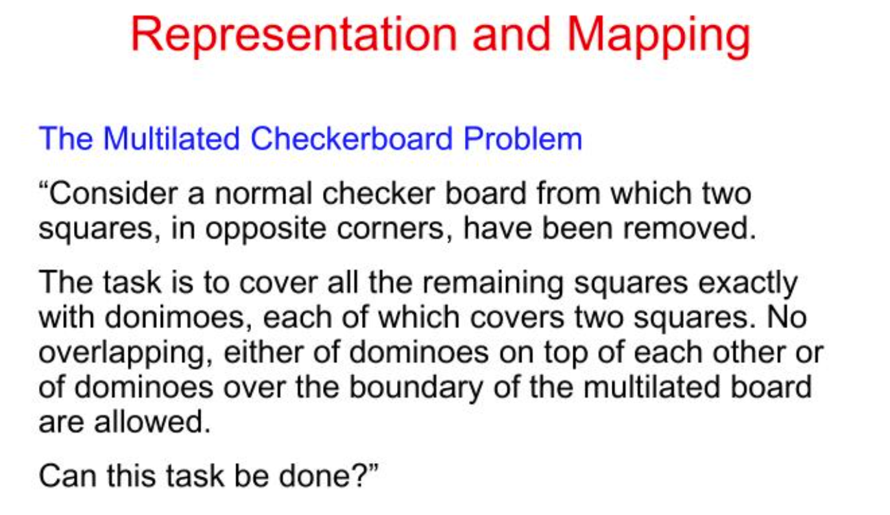

Slide 22
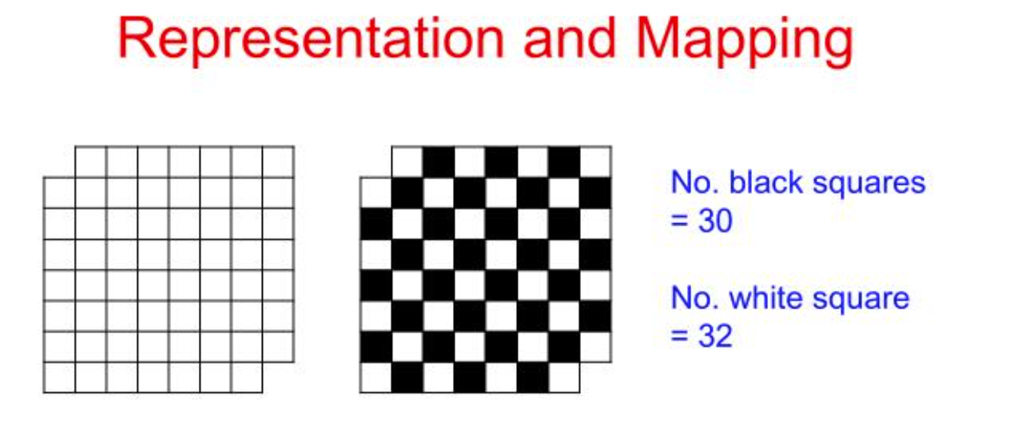

Slide 23
Approaches to Knowledge Representation

Slide 24
Knowledge representation
The Problem solving requires,
  Knowledge ( set of facts)
  Formal knowledge representation, and
  Moreover, Conversion of informal knowledge to a formal knowledge that is the conversion of implicit knowledge to explicit knowledge.

Slide 25
Mapping between Facts and Representation
  Knowledge is a collection of facts from some domain.
  Also, We need a representation of “facts” that can manipulate by a program.
  Moreover, Normal English is insufficient, too hard currently for a computer program to draw inferences in natural languages.
  Thus some symbolic representation is necessary.
Consider:
"Ravi is a good student and he usually attends classes."
For humans, this is understandable.
But what exactly does good mean?
Does it mean:
High marks?
Good attendance?
Good behaviour?
Therefore, we convert it into structured knowledge:
Student(Ravi)
Attendance(Ravi,High)
Marks(Ravi,90)
Now the computer can process the information more reliably.

Slide 26
Properties of good knowledge representation system
Representational Adequacy
  The ability to represent all kinds of knowledge that are needed in that domain.
Inferential Adequacy
  Also, The ability to manipulate the representational structures to derive new structures corresponding to new knowledge inferred from old.
Inferential Efficiency
  The ability to incorporate additional information into the knowledge structure that can be used to focus the attention of the inference mechanisms in the most promising direction.
Acquisitional Efficiency
  Moreover, The ability to acquire new knowledge using automatic methods wherever possible rather than reliance on human intervention.

Slide 27
Representational Adequacy
Meaning
The system should be able to represent all the necessary knowledge of the domain.
Example
For a university system, we may need:
Student
Teacher
Course
Department
Enrollment
Marks
Attendance
If the KR system cannot represent relationships such as:
Student → enrolled in → Course
then it does not have sufficient representational adequacy.
Simple definition
Can the system represent the required knowledge?

Slide 28
Inferential Adequacy
Meaning
The system should be able to derive new knowledge from existing knowledge.
Example
Given:
Student(Ravi)
and:
Student(x) → Enrolled(x,AI)
the system should derive:
Enrolled(Ravi,AI)
Simple definition
Can the system derive new knowledge?

Slide 29
Inferential Efficiency
Meaning
The system should perform reasoning efficiently.
Suppose a knowledge base contains:
1,000,000 facts
and we want to determine:
Is Ravi enrolled in AI?
A good KR system should quickly focus on relevant information rather than checking every unrelated fact.
Simple definition
Can the system reason efficiently?

Slide 30
Acquisitional Efficiency
Meaning
The system should be able to acquire new knowledge easily, preferably automatically.
For example, an AI medical system can receive new information:
Patient has fever.
Patient has cough.
Patient has fatigue.
and add it to its knowledge base.
Simple definition
Can the system easily learn/acquire new knowledge?

Slide 31
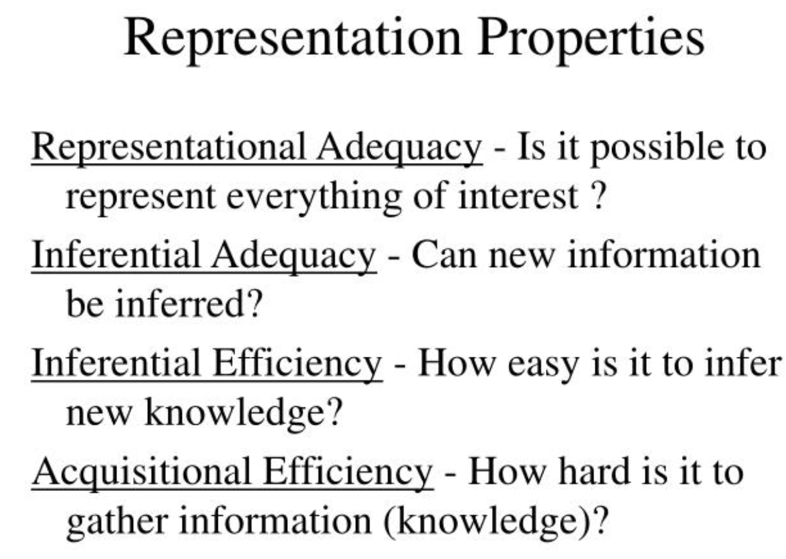

Slide 32
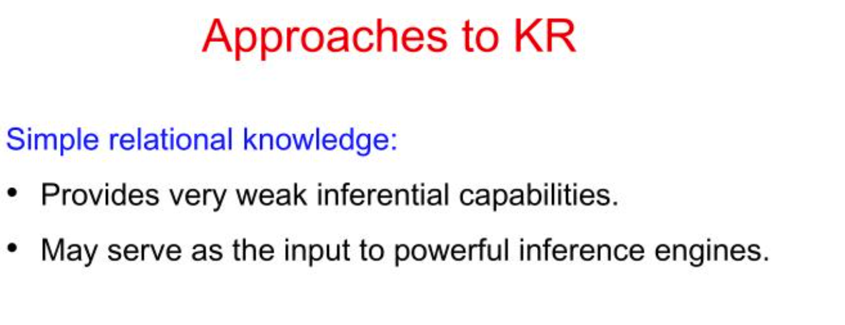

Slide 33
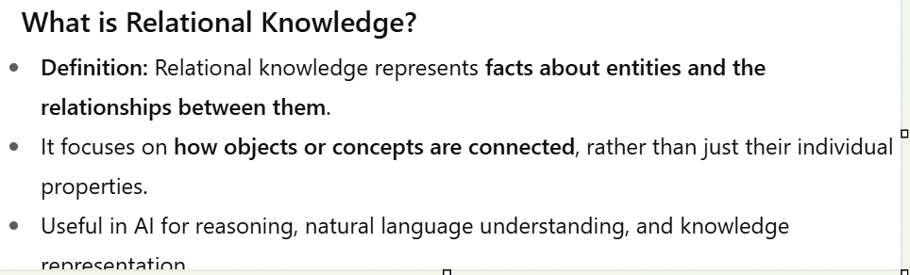
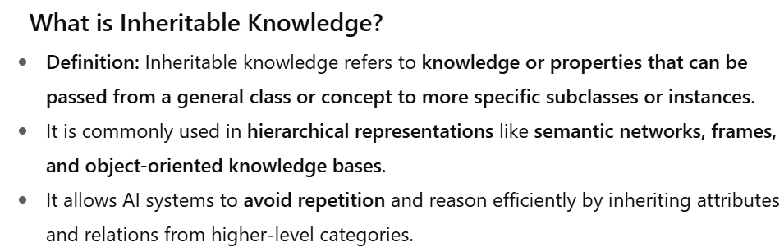
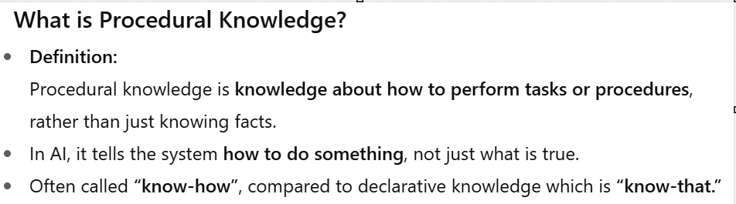
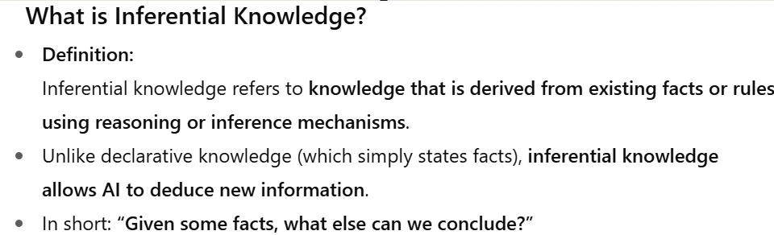
Approaches to Knowledge representation
Relational Knowledge
Inheritable knowledge
Inferential knowledge
Procedural Knowledge

Slide 34
Points to remember
Relational → relationships
Inheritable → inheritance
Inferential → reasoning
Procedural → how to do something

Slide 35
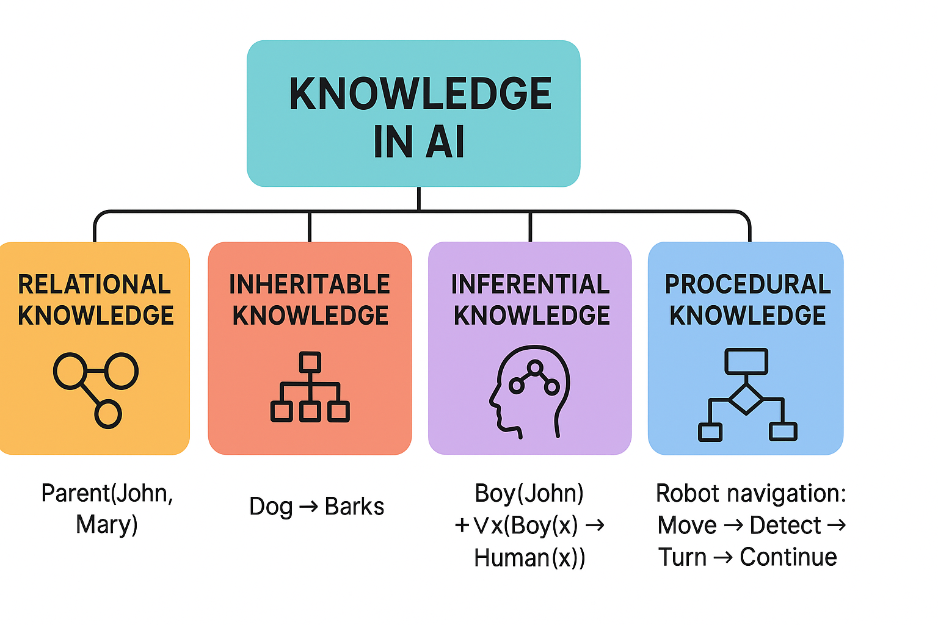
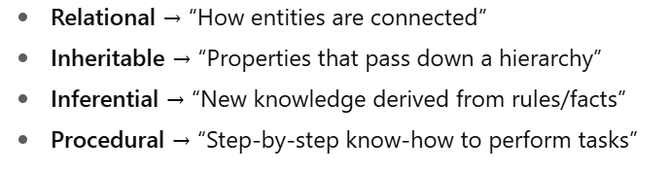
Approaches to knowledge representation - summary

Slide 36

Relational Knowledge
  The simplest way to represent declarative facts is a set of relations of the same sort used in the database system.
  Provides a framework to compare two objects based on equivalent attributes. Any instance in which two different objects are compared is a relational type of knowledge.
  The table below shows a simple way to store facts.
    The facts about a set of objects are put systematically in columns.
    This representation provides little opportunity for inference.
  Given the facts, it is not possible to answer a simple question such as: “Who is brother of Ruth?”
  But if a procedure for finding the heaviest player is provided, then these facts will enable that procedure to compute an answer.
  Moreover, We can ask things like who “bats – left” and “throws – right”.

Slide 37
Relational Knowledge
Student | Course | Mark
Ravi | AI | 85
Priya | AI | 92
Arun | ML | 78
Why "relational"?
Because information is stored as relationships between objects.
For example:
Enrolled(Ravi,AI)
means:
Ravi is related to AI through the Enrolled relationship.

Slide 38
limitation
Person | Parent
Ravi | Kumar
Anu | Kumar
But simply storing the data does not automatically tell us:
Who is the brother of Anu?
We need an additional rule:
If two people have the same parent, then they may be siblings.
So relational representation mainly stores facts; additional inference mechanisms are required for reasoning.

Slide 39
Inheritable Knowledge
  The knowledge elements inherit attributes from their parents.
  The knowledge embodied in the design hierarchies found in the functional, physical and process domains.
  Within the hierarchy, elements inherit attributes from their parents, but in many cases, not all attributes of the parent elements prescribed to the child elements.
  Also, The inheritance is a powerful form of inference, but not adequate.
  Moreover, The basic KR (Knowledge Representation) needs to augment with inference mechanism.
  Property inheritance: The objects or elements of specific classes inherit attributes and values from more general classes. So, the classes organized in a generalized hierarchy.

Slide 40
Inheritable Knowledge
This is similar to inheritance in Object-Oriented Programming.
Example:
Animal
/ \
Dog Cat
Suppose:
Animal → hasEyes
Animal → breathes
Then:
Dog → hasEyes
Dog → breathes
Cat → hasEyes
Cat → breathes
The child classes inherit properties from the parent.

Slide 41
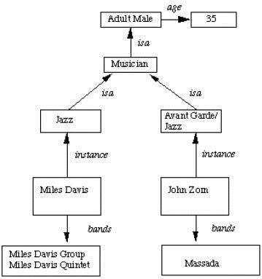
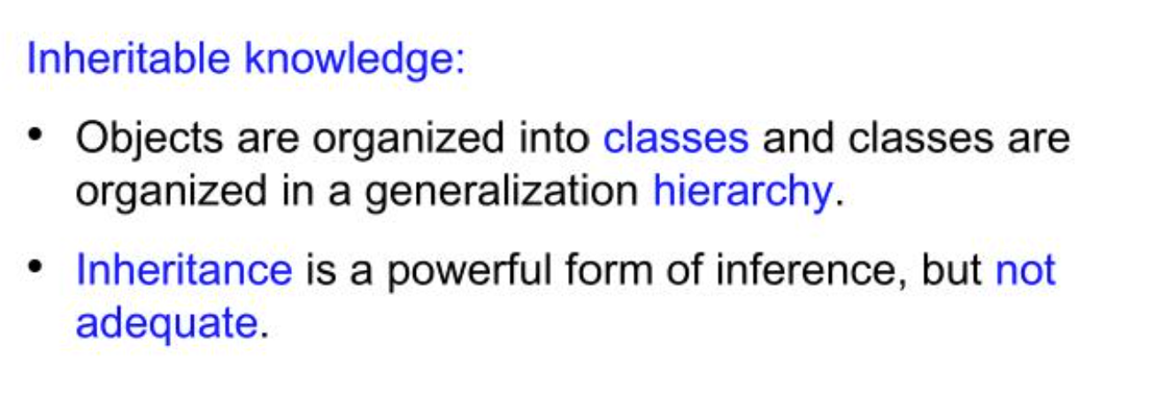
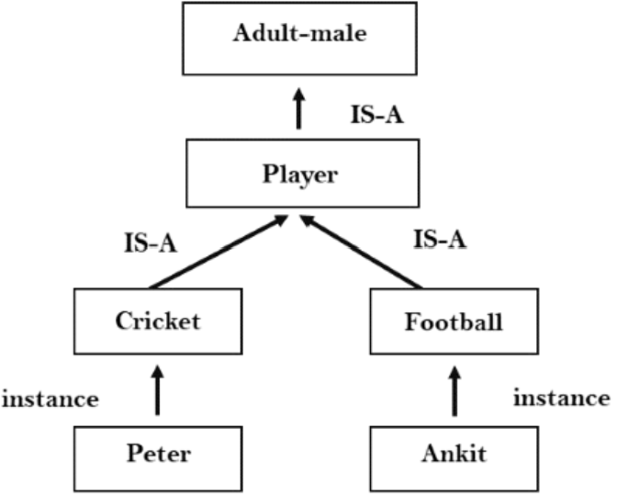
Inheritable Knowledge
Objects and values are represented in Boxed nodes.
Use Arrows which point from objects to their values.

Slide 42
Real life example
Vehicle
|
↓
Car
|
↓
Electric Car
Suppose:
Vehicle → hasWheels
Car → hasEngine
Electric Car → usesBattery
An electric car can inherit:
hasWheels
hasEngine
from its parent classes, depending on the hierarchy.

Slide 43
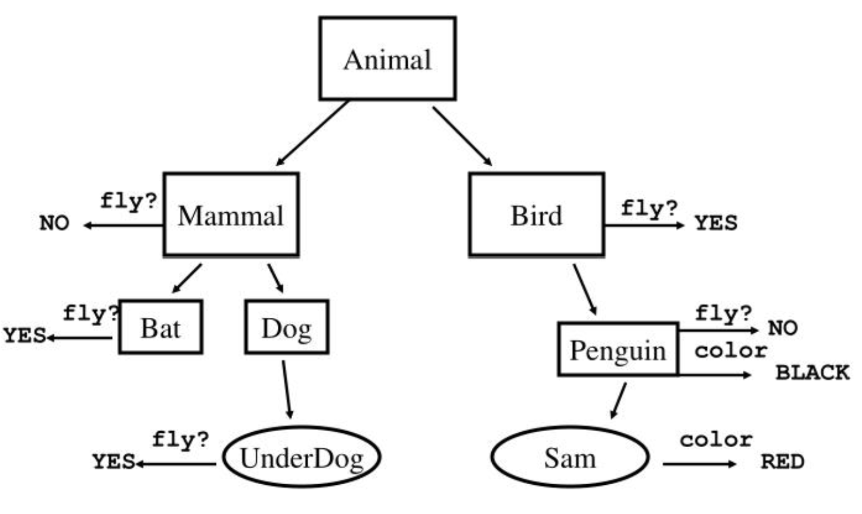
Inheritable Knowledge

Slide 44
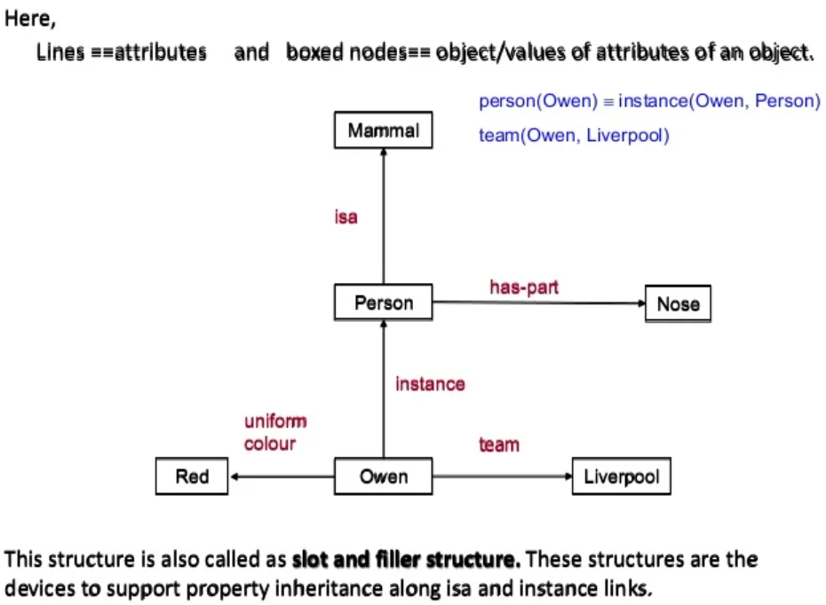
Inheritable Knowledge
  Boxed nodes — objects and values of attributes of objects.
  Arrows — the point from object to its value.
  This structure is known as a slot and filler structure, semantic network or a collection of frames.

Slide 45
A slot is an attribute-value pair, and a filler is a value that a slot can take.
Example:
CAR
----------------
Color → Red
Model → Tesla
Wheels → 4
Battery → 80 kWh
Here:
Color = slot
Red = filler
Model = slot
Tesla = filler
Wheels = slot
4 = filler
So:
Slot Filler
-----------------
Color Red
Model Tesla
Wheels 4

Slide 46
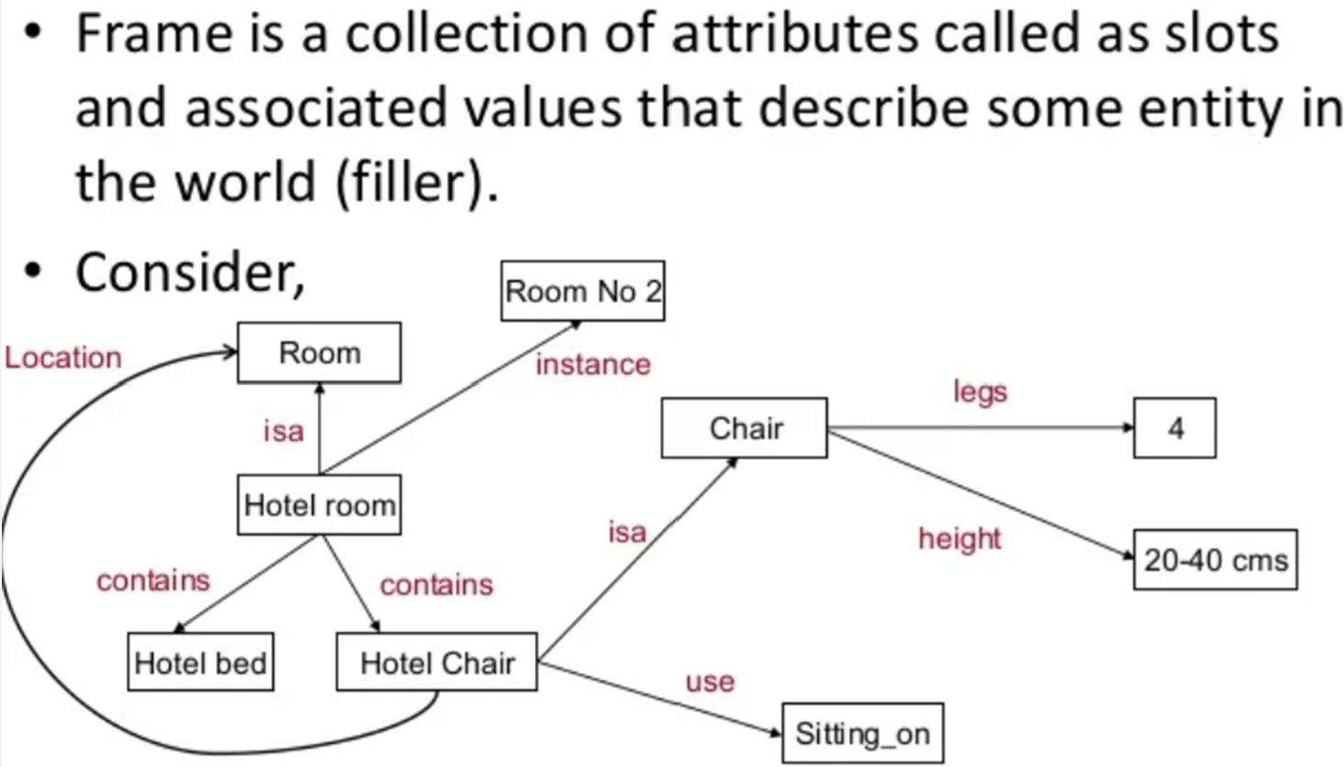
Frames
Weak slot and filler structures allow for quick retrieval of attribute values, easy description of relation properties, and embrace aspects of object-oriented programming.
A slot is an attribute-value pair, and a filler is a value that a slot can take.

Slide 47
Frames
STUDENT
--------------------
Name → Ravi
Age → 20
Department → CSE
Course → AI
CGPA → 8.5

Slide 48
Inferential Knowledge
  This knowledge generates new information from the given information.
  This new information does not require further data gathering from source but does require analysis of the given information to generate new knowledge.
  Example: given a set of relations and values, one may infer other values or relations.
  A predicate logic (a mathematical deduction) used to infer from a set of attributes. Moreover, Inference through predicate logic uses a set of logical operations to relate individual data.
  Represent knowledge as formal logic: All dogs have tails ∀x: dog(x) → hastail(x)
  Advantages:
    A set of strict rules.
    Can use to derive more facts.
    Also, Truths of new statements can be verified.
    Guaranteed correctness.
  So, Many inference procedures available to implement standard rules of logic popular in AI systems. e.g Automated theorem proving.

Slide 49
Inferential knowledge
This knowledge generates new information from the given information.
This is reasoning.
Example:
Given:
Dog(Bruno)
Rule:
Dog(x) → Animal(x)
Inference:
Animal(Bruno)
The system did not receive Animal(Bruno) directly.
It derived it.

Slide 50
Predicate Logic for Inference
∀x: dog(x) → hastail(x)
Suppose:
dog(Bruno)
Then:
dog(Bruno)
+
∀x(dog(x) → hastail(x))
↓
hastail(Bruno)
This is the core idea of logical inference.

Slide 51
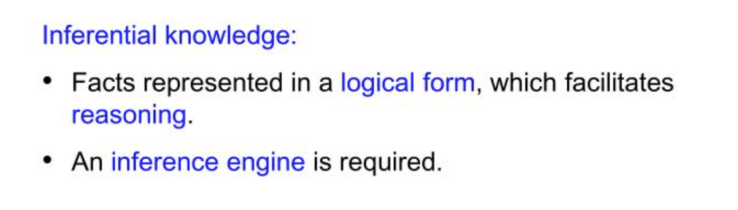
Inferential Knowledge

Slide 52
Procedural Knowledge
  A representation in which the control information, to use the knowledge, embedded in the knowledge itself.
  For example, computer programs, directions, and recipes; these indicate specific use or implementation.
LISP
Prolog
Eg. If: headache and Fever
Then: viral fever

Slide 53
Simple recipe example
Consider:
How do you make tea?
Procedural knowledge:
1. Boil water.
2. Add tea powder.
3. Add milk.
4. Add sugar.
5. Boil for 2 minutes.
6. Serve.
This tells us how to perform the task.

Slide 54
Medical expert system
IF headache AND fever
THEN viral fever
Suppose:
Headache(Patient1)
Fever(Patient1)
The rule is:
Headache(x) AND Fever(x)
↓
ViralFever(x)
Therefore:
ViralFever(Patient1)
This is a simple example of a rule-based expert system.

Slide 55
Procedural Knowledge
  Advantages:
    Heuristic or domain-specific knowledge can represent.
    Moreover, Extended logical inferences, such as default reasoning facilitated.
    Also, Side effects of actions may become false in time. Keeping track of this in large systems may be tricky.
  Disadvantages:
    Completeness — not all cases may be represent.
    Consistency — not all deductions may be correct.
    e.g If we know that Fred is a bird we might deduce that Fred can fly. Later we might discover that Fred is an emu.
    Modularity sacrificed. Changes in knowledge base might have far-reaching effects.
    Cumbersome control information.

